Slide 1

Decoded Change Detection
Get ready to go Zoneless
Khang Tran
Catfish Team
Angular Enthusiast

Slide 2
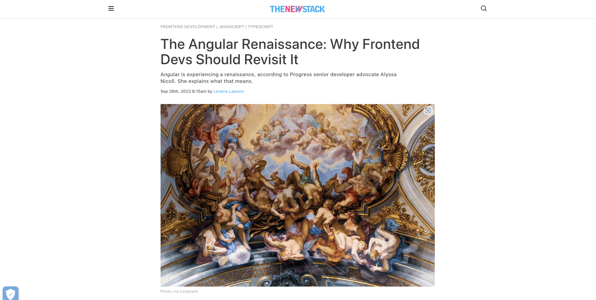

Slide 3
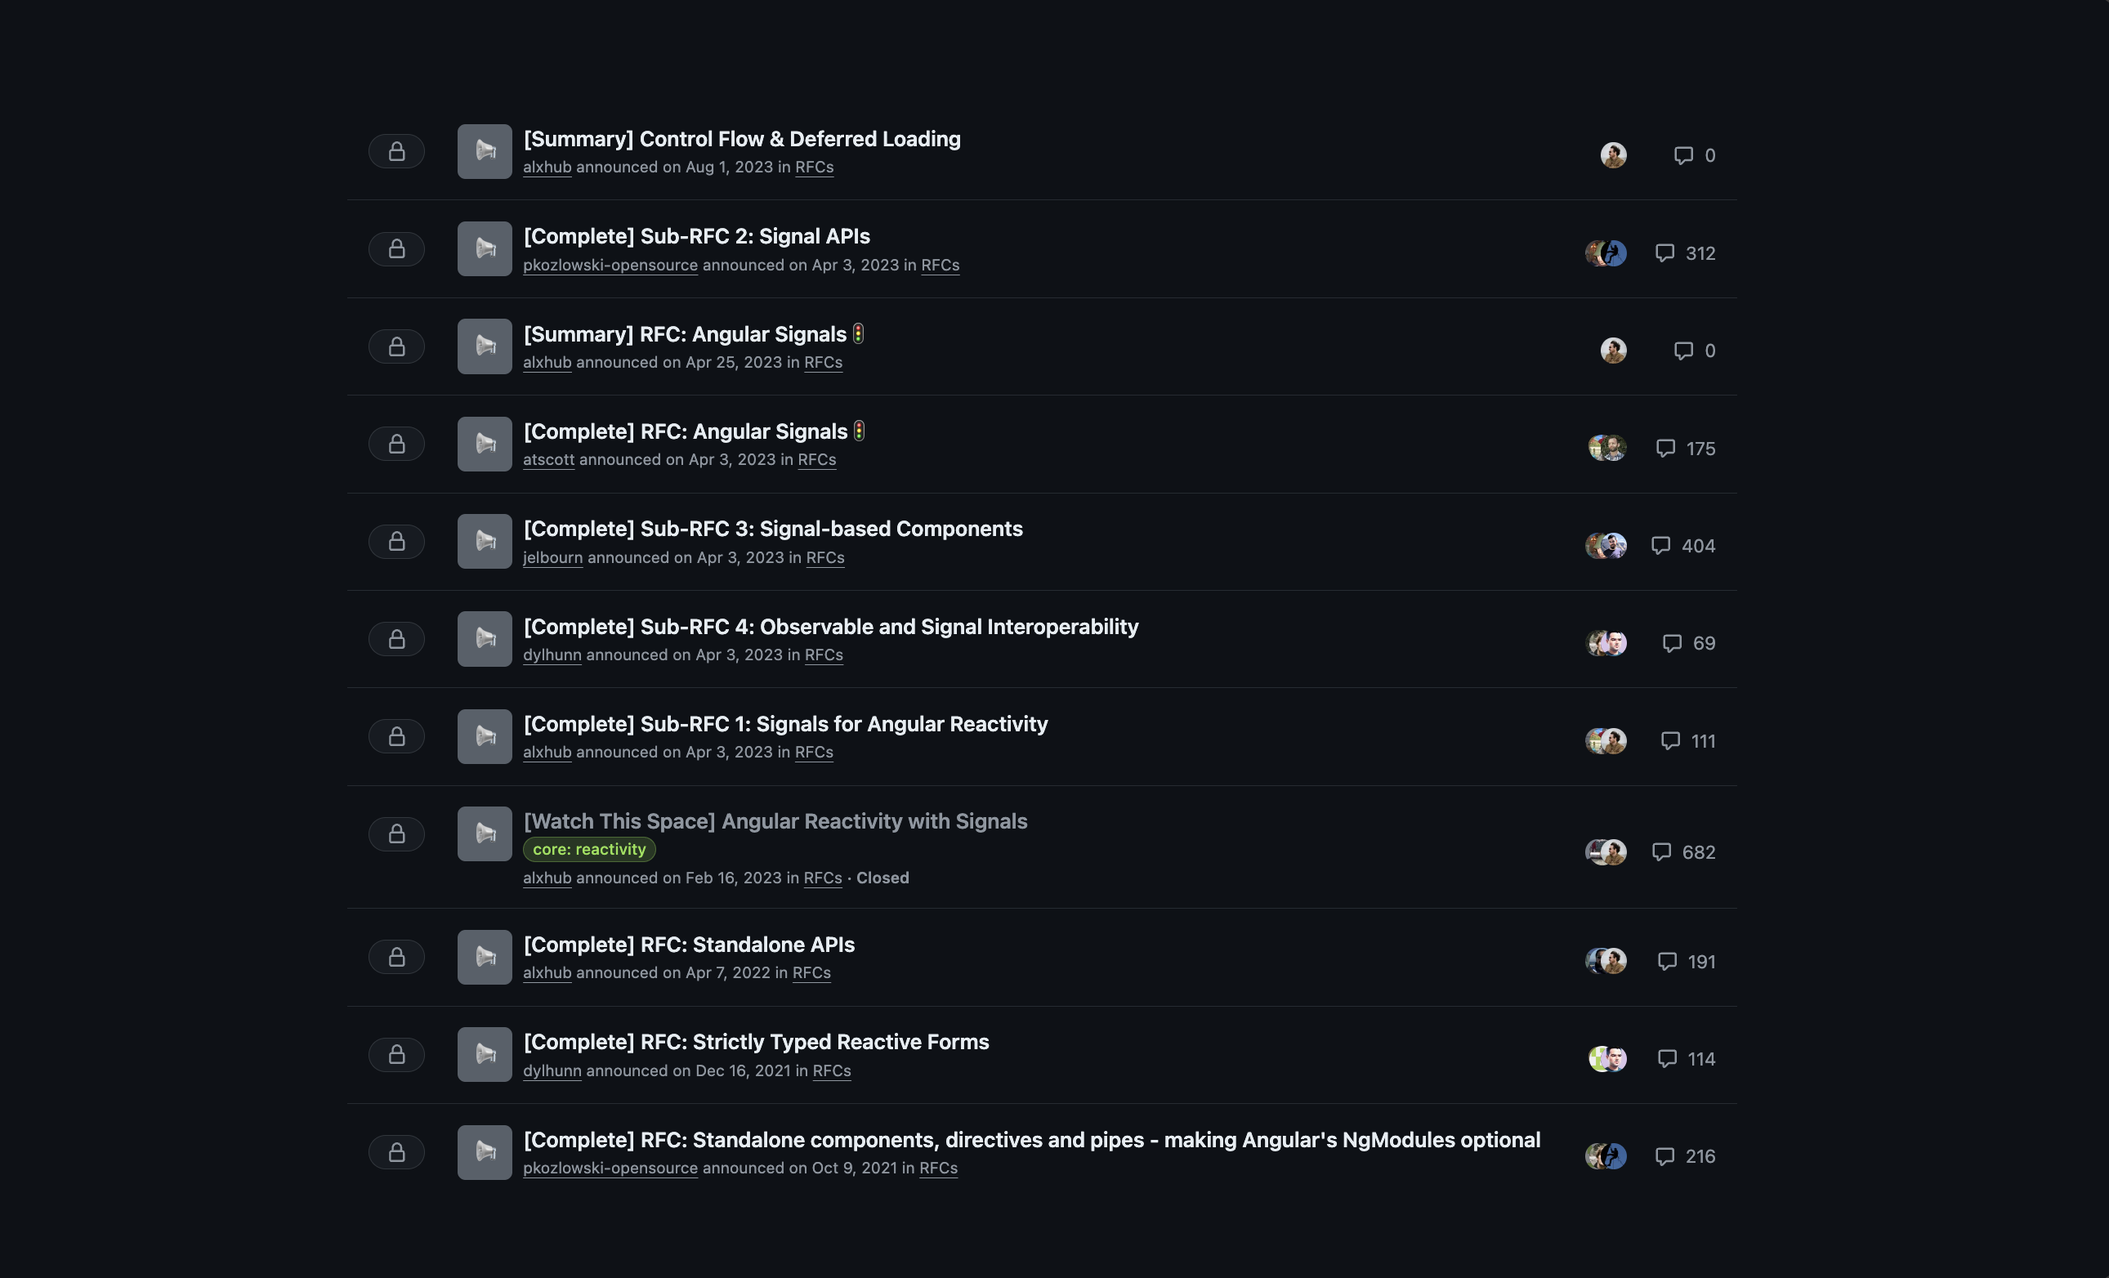

Slide 4
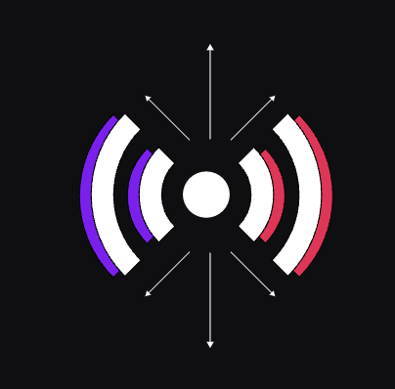
Angular Signals APIs*

Slide 5
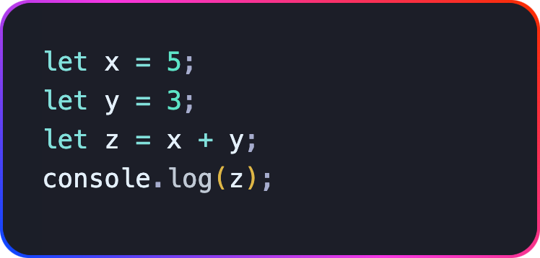
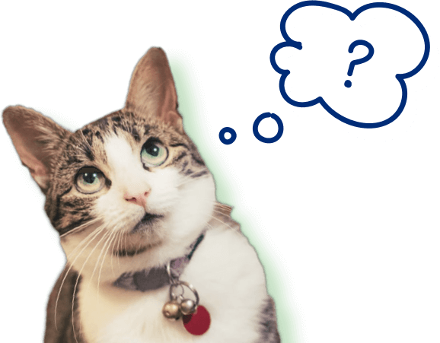
What is Z?
8

Slide 6
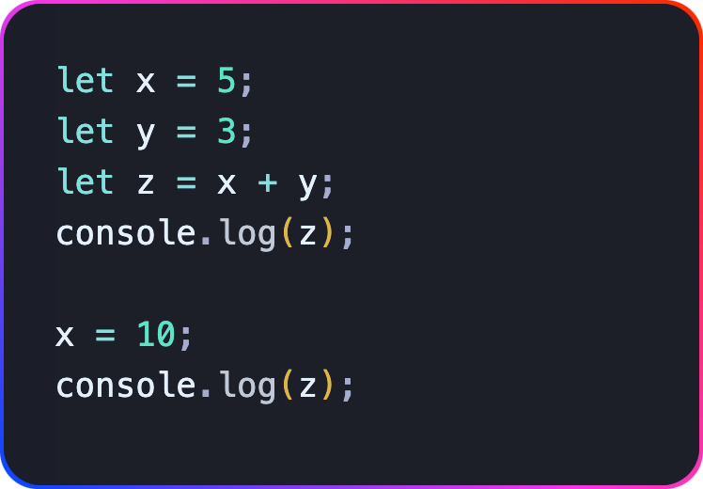
Now what is Z?
8

Slide 7
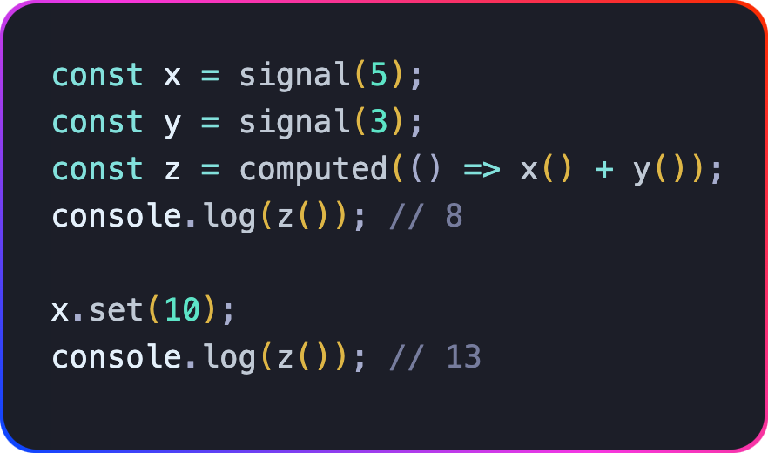
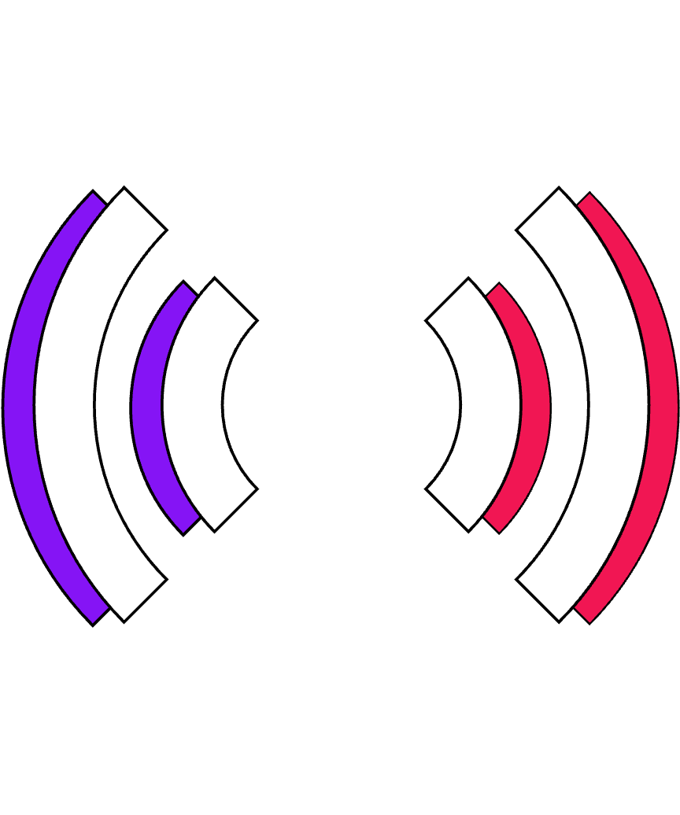

Slide 8
A signal is a wrapper around a value that notifies interested consumers when that value changes.
https://angular.dev/guide/signals

Slide 9
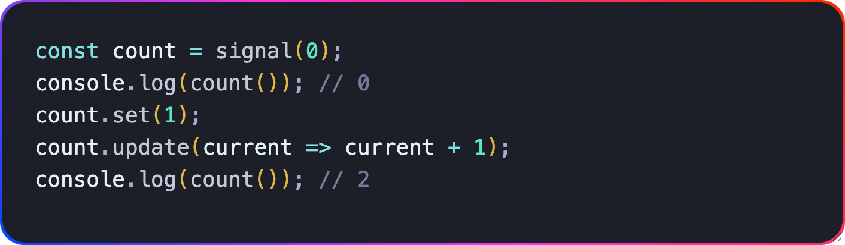
Signals
The signal<T>() function creates a signal
The count has type WritableSignal<number>
The set replaces the value
The update creates new value from old (immutable)
Value is retrieved by “calling” the signal (getter)
Sync & Guaranteed to always have a value

Slide 10

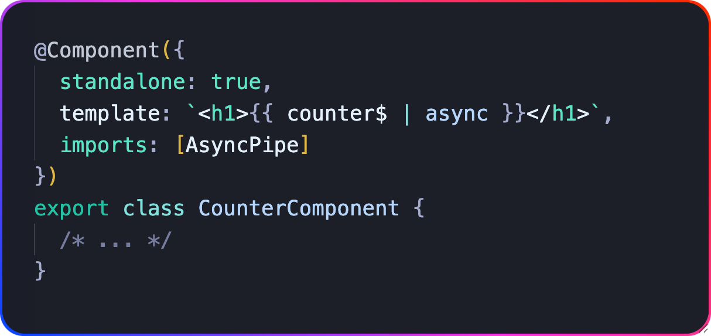

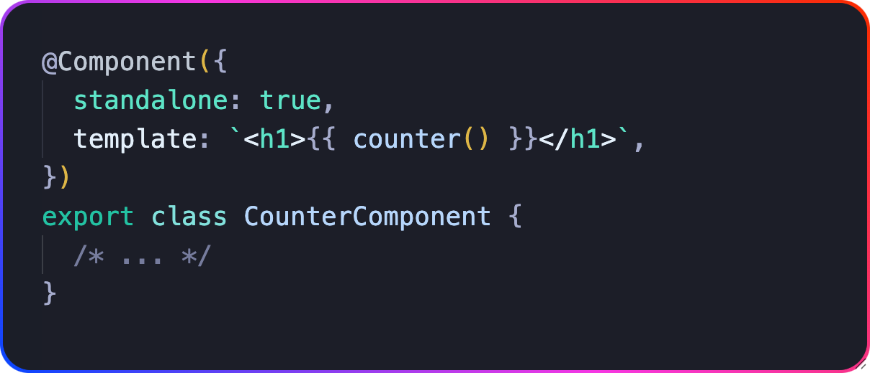
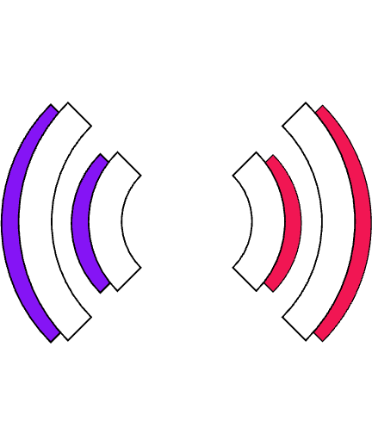
markForCheck()

Slide 11
Computed signal are read-only signals that derive their value from other signals.
https://angular.dev/guide/signals#computed-signals

Slide 12
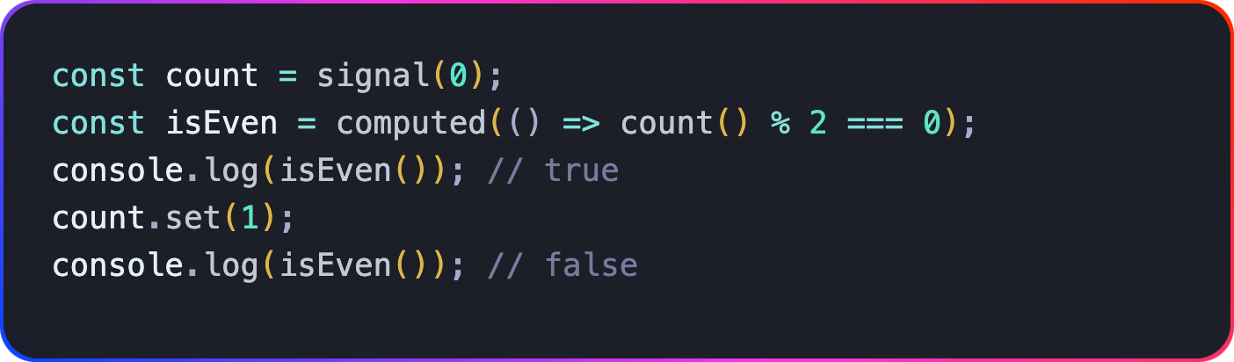
Computed Signals
Creates new read-only Signal isEven: Signal<boolean>
Computes derived state, from signals (1 to n)
Can be reused in other computed

Slide 13
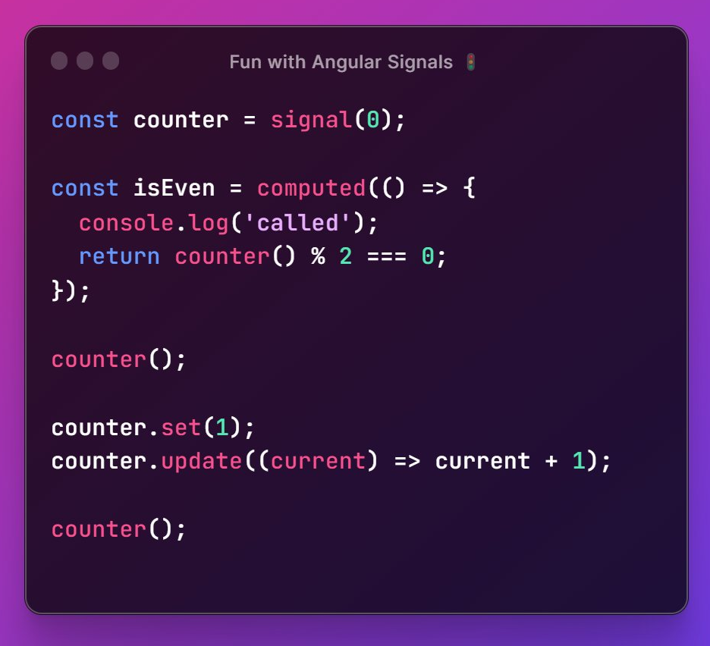
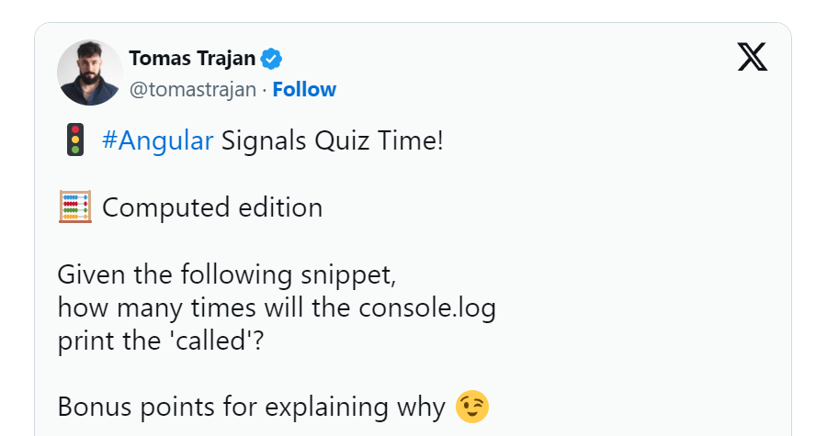
Notes:
So who thinks 3 times?
Who thinks 2 times
Who thinks 0 times ?
Let’s explain in the next slide

Slide 14

Memoized
Lazy Evaluation

Slide 15
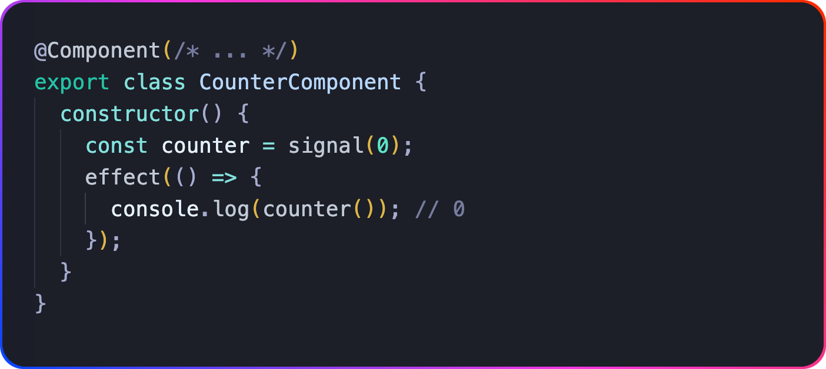
Signals effects
Have to run in injection context
Runs at start AND when referenced Signals change*
Automatic cleanup

Slide 16
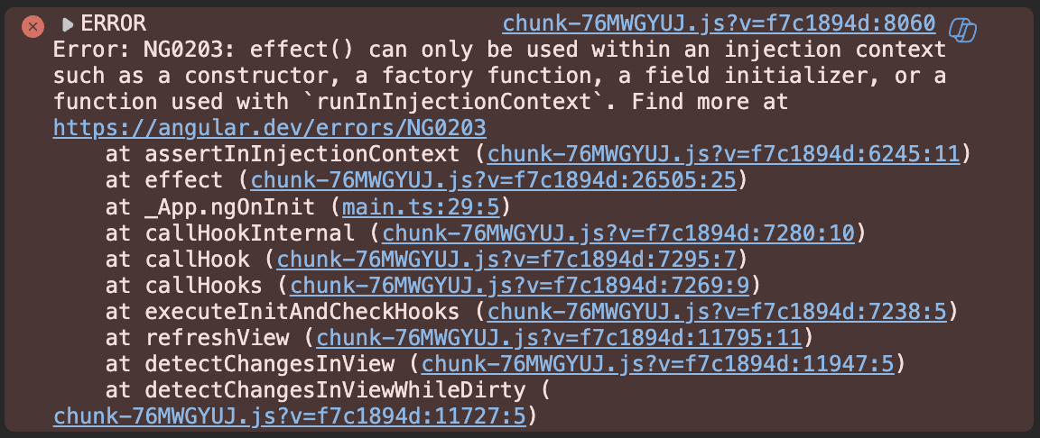
Signals effects

Slide 17
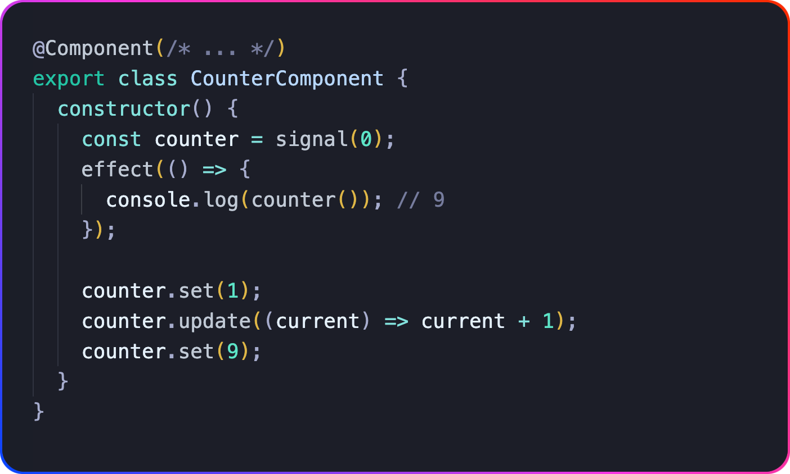
Effects always excute asynchronously

Slide 18
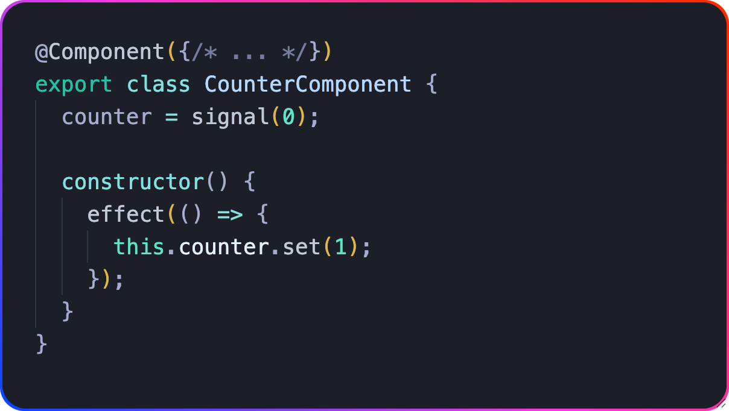
Effects updating Signals

Slide 19
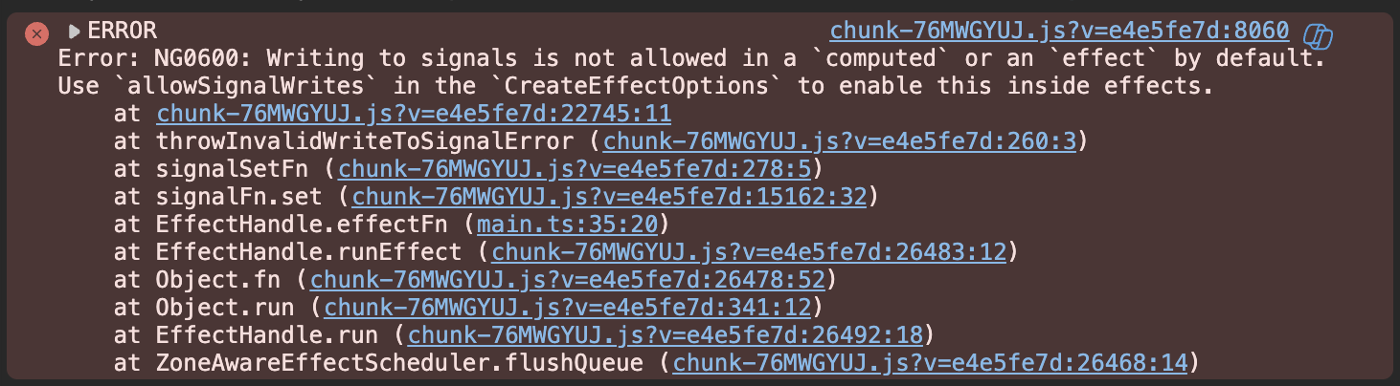
Effects updating Signals

Slide 20
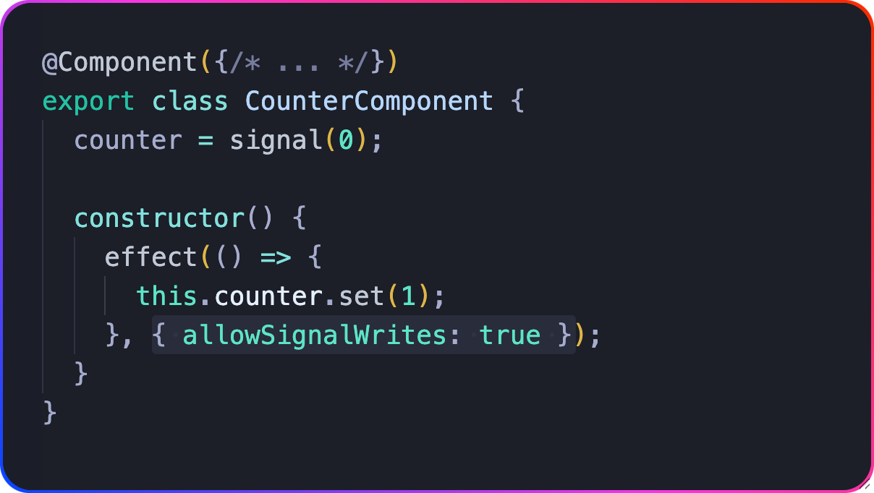
Effects updating Signals

Slide 21
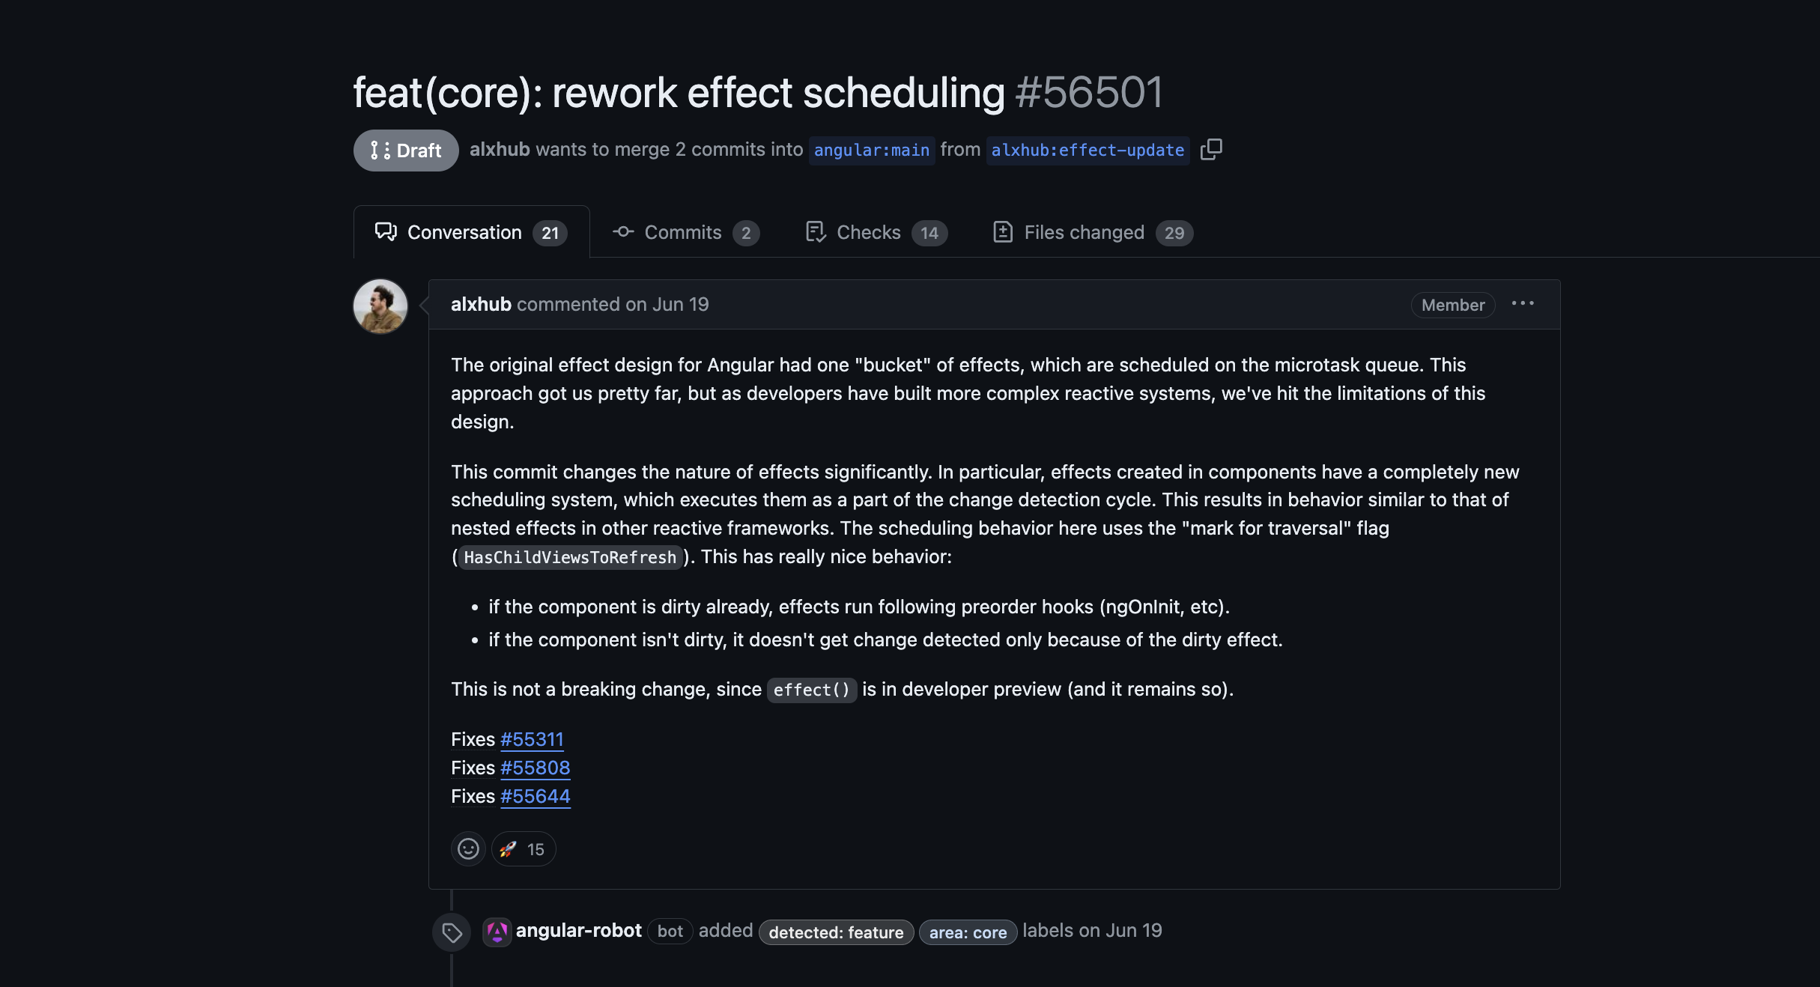

Slide 22

Dependency Graph
Signal Input
Active Consumer
Consumer
toSignal
Producer
Model Input
Reactive Context
Live Consumer
toObservable
Fine-grained Reactivity
Transitive Live Consumer
viewChildren
Push/Pull/Poll Algorithm
viewChild
contentChild
NgRx SignalStore
contentChildren
NgRx selectSignal
Notes:
https://jeanmeche.github.io/angular-change-detection/

Slide 23
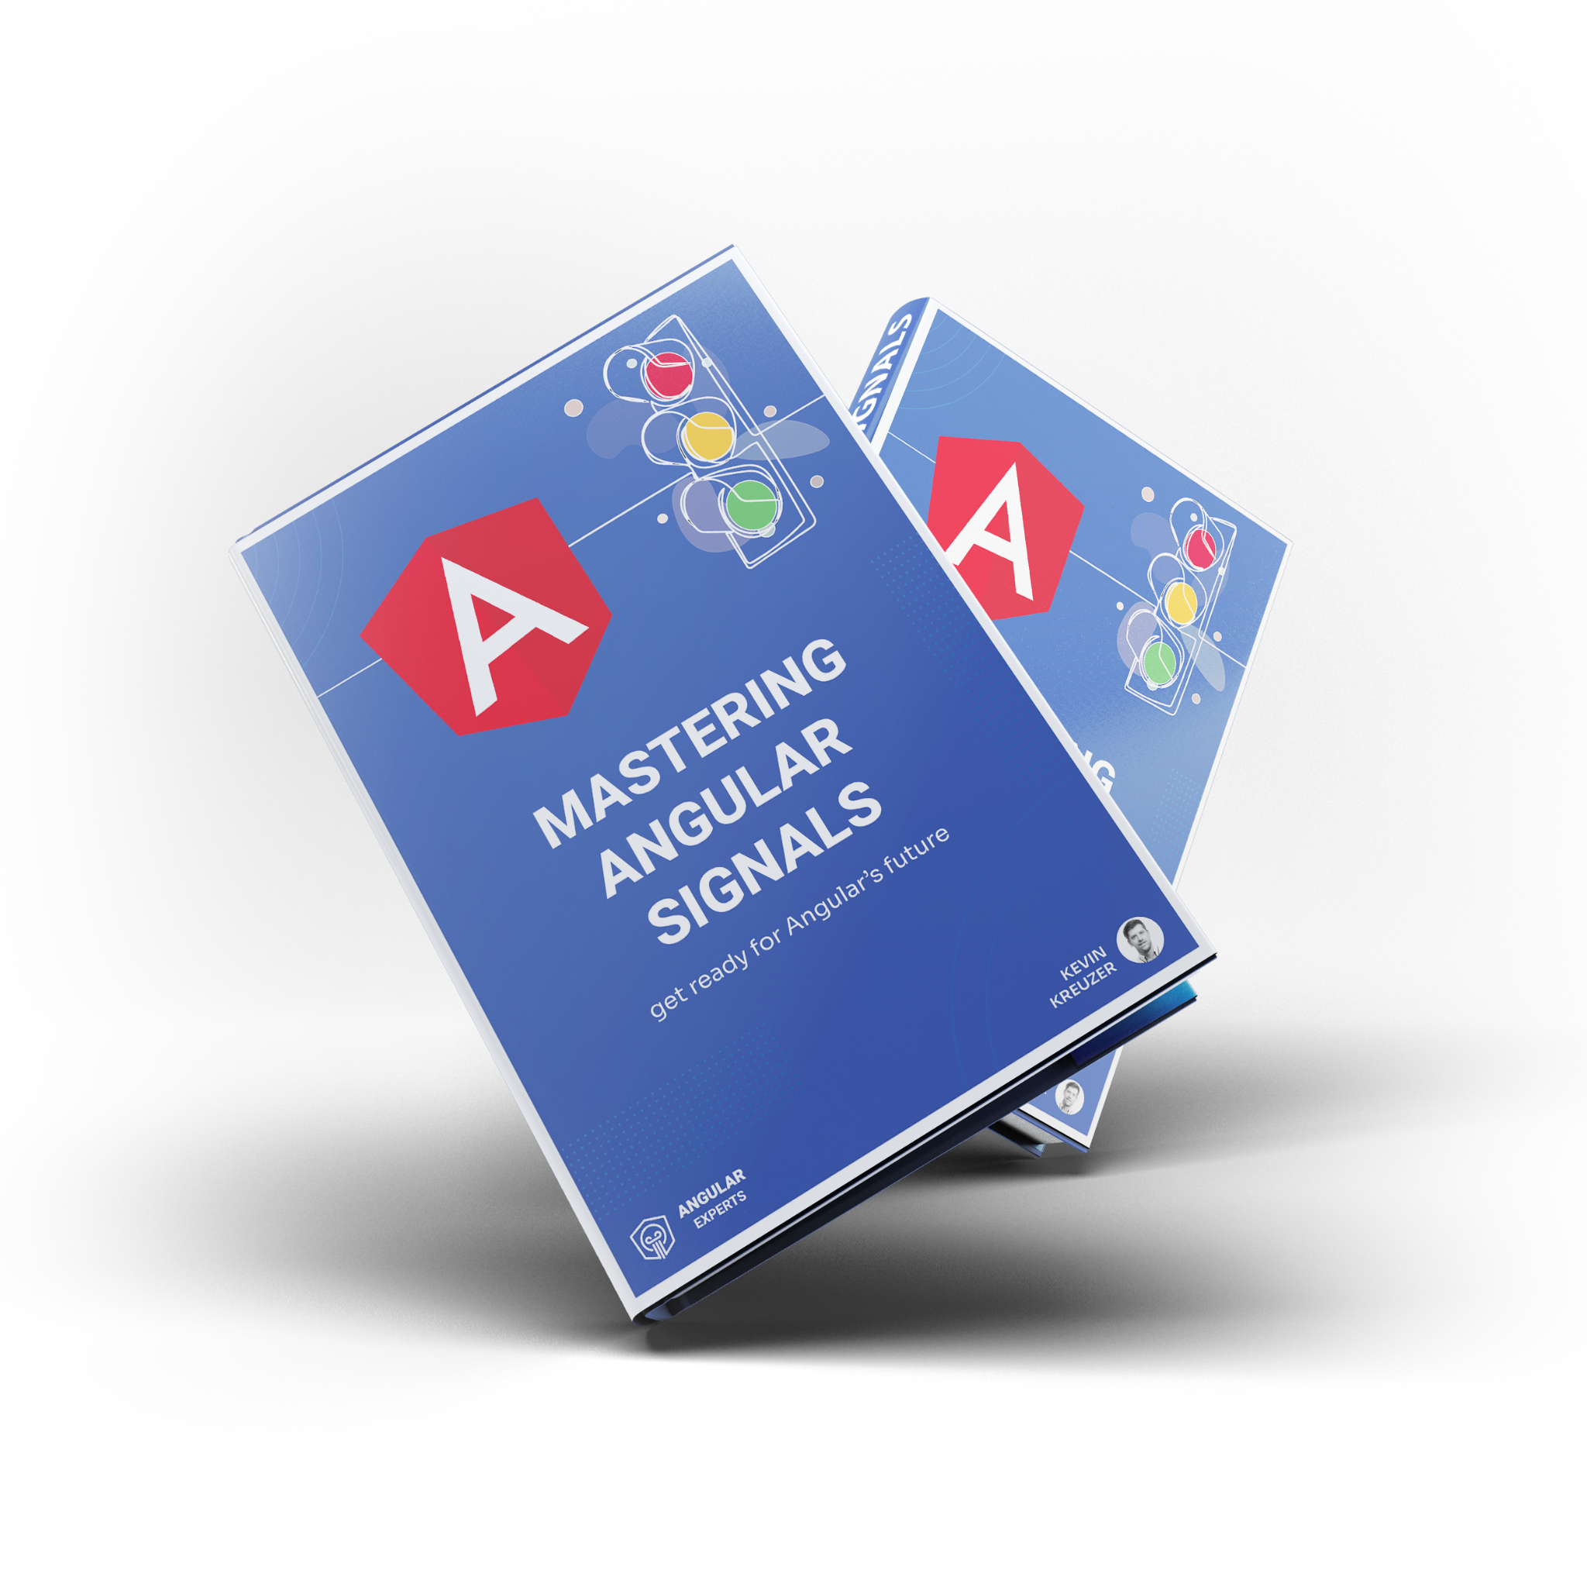
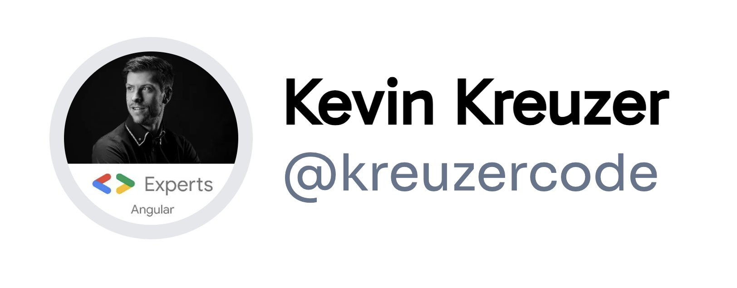
Angular Signals Book

Slide 24
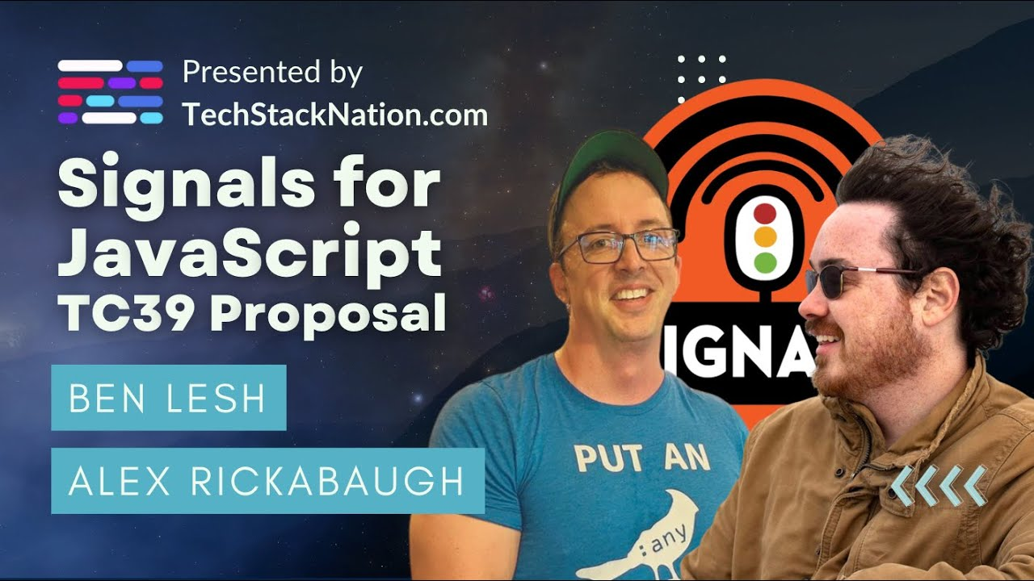

Slide 25
Angular Change Detection

Slide 26
Signals will enable Angular to achieve more fine-grained reactivity by providing finer control over change detection, leading to improved performance and responsiveness.

Slide 27

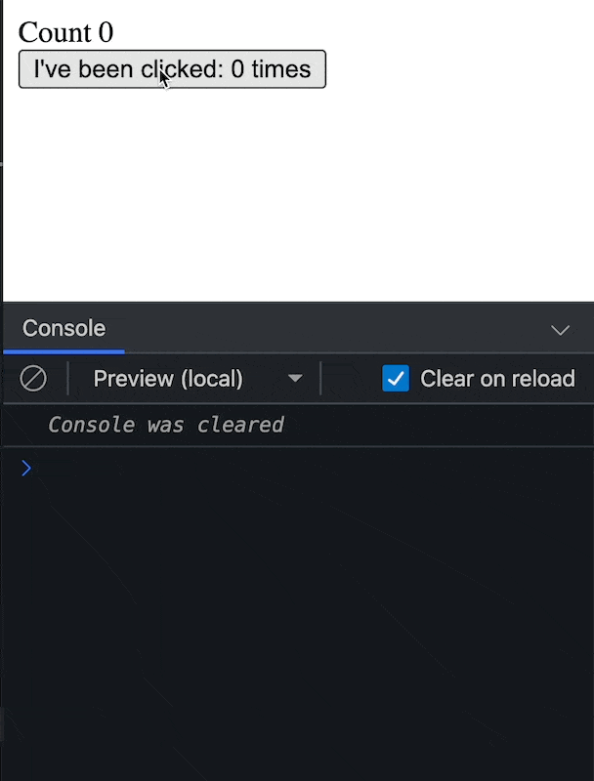
Have you ever wondered
how does this work?

Slide 28
Change detection is the process through which Angular checks to see whether your application state has changed,
and if any DOM needs to be updated

Slide 29
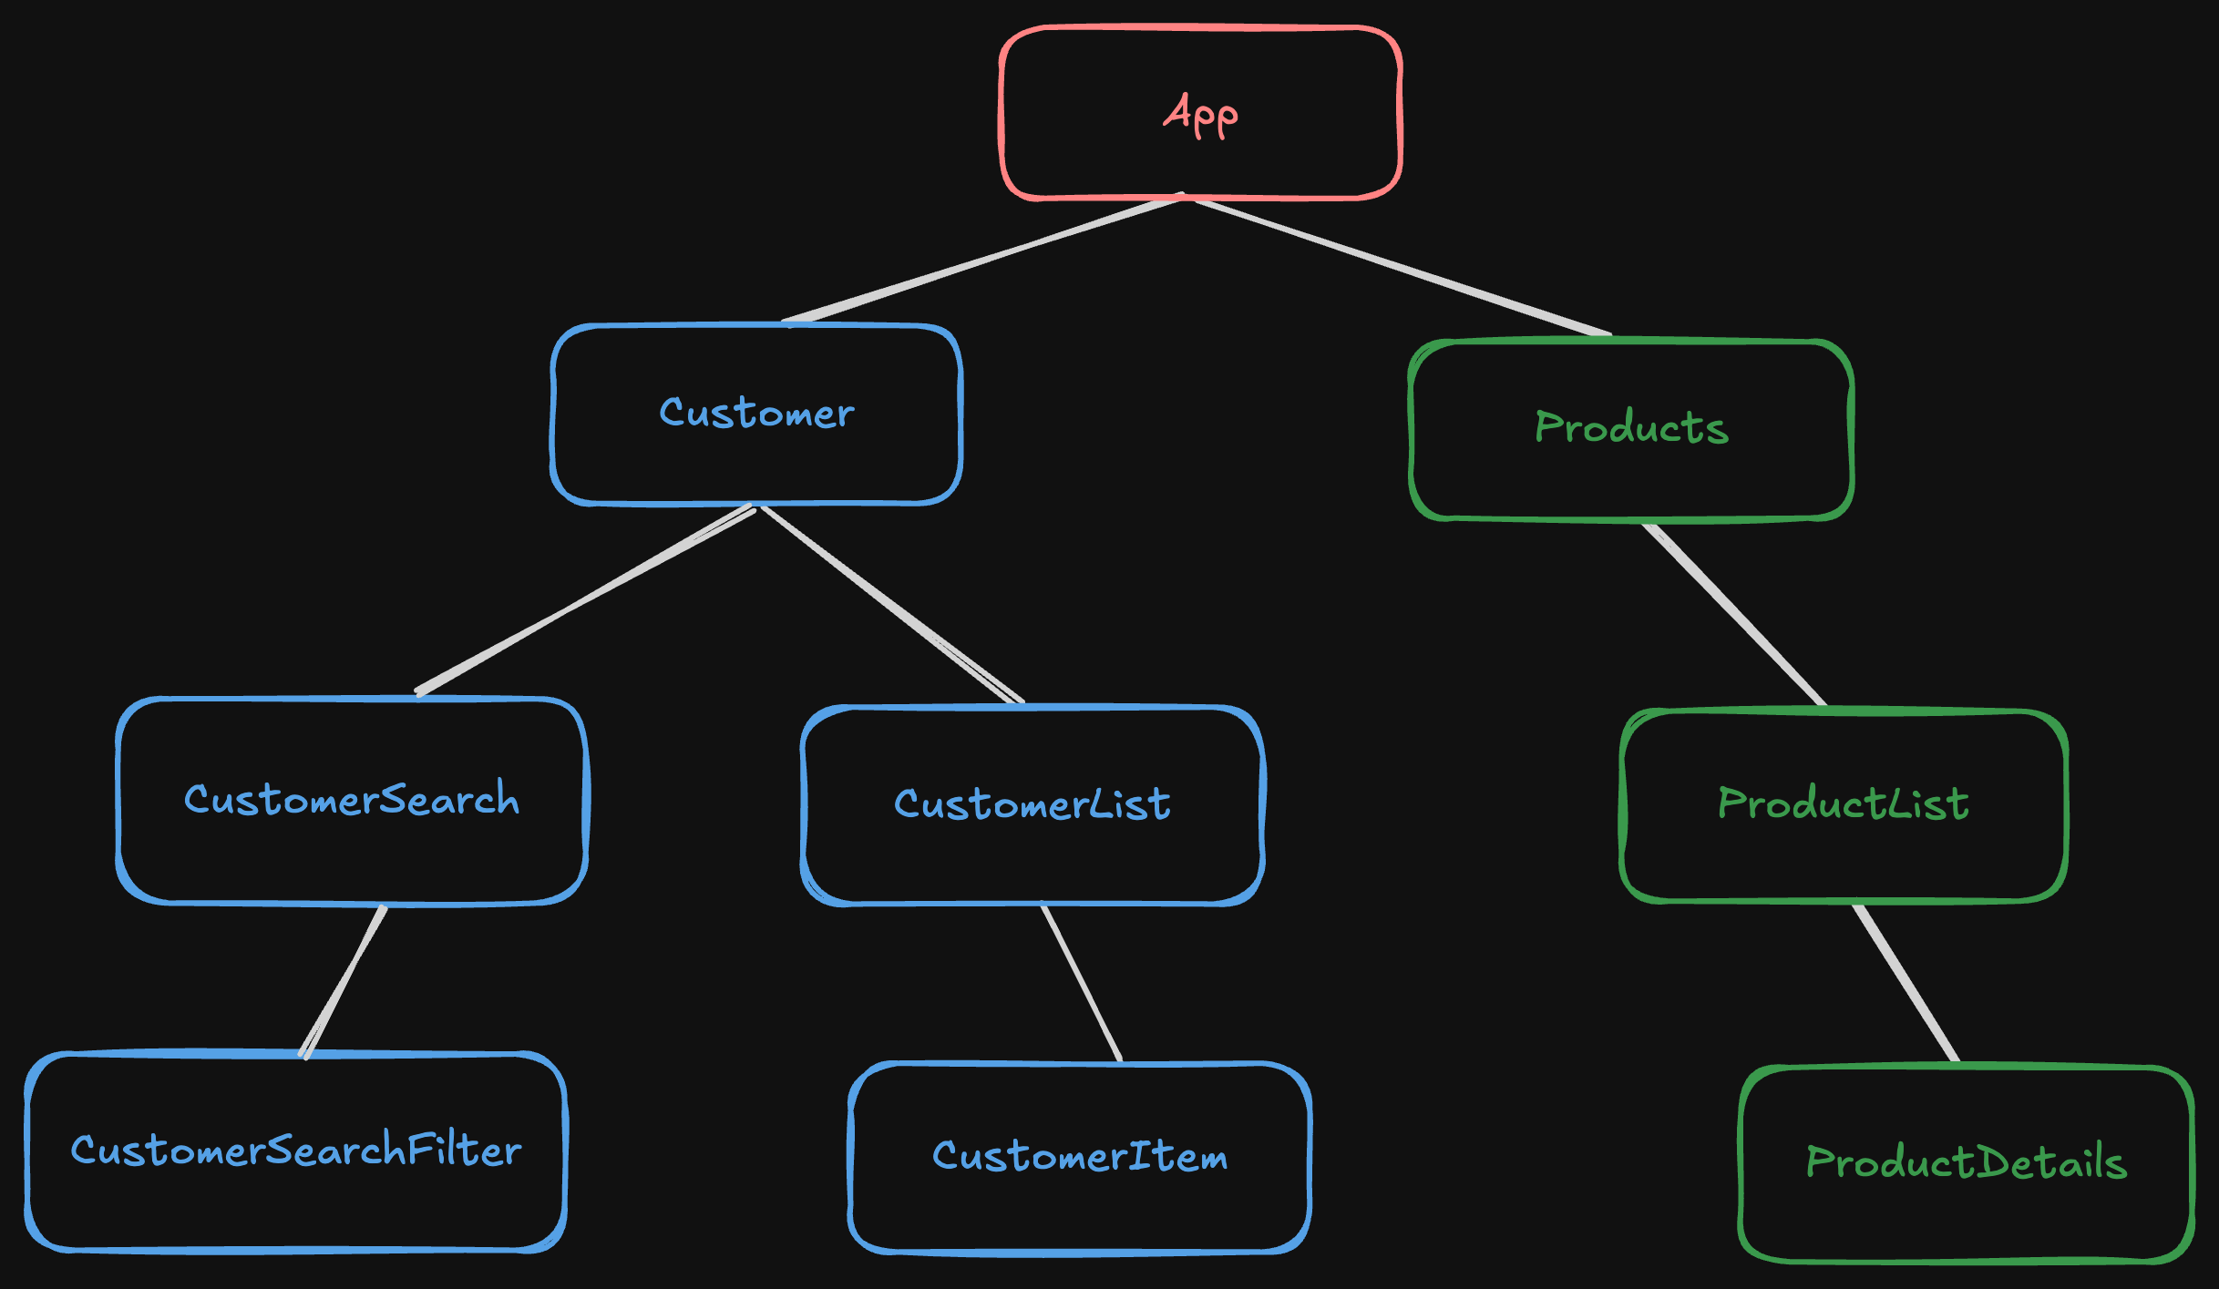
Angular
Component Tree

Slide 30

ZoneJS
Zone.js monkey patches almost all the browser API-s
in order to get notified whenever an event happens!

Slide 31
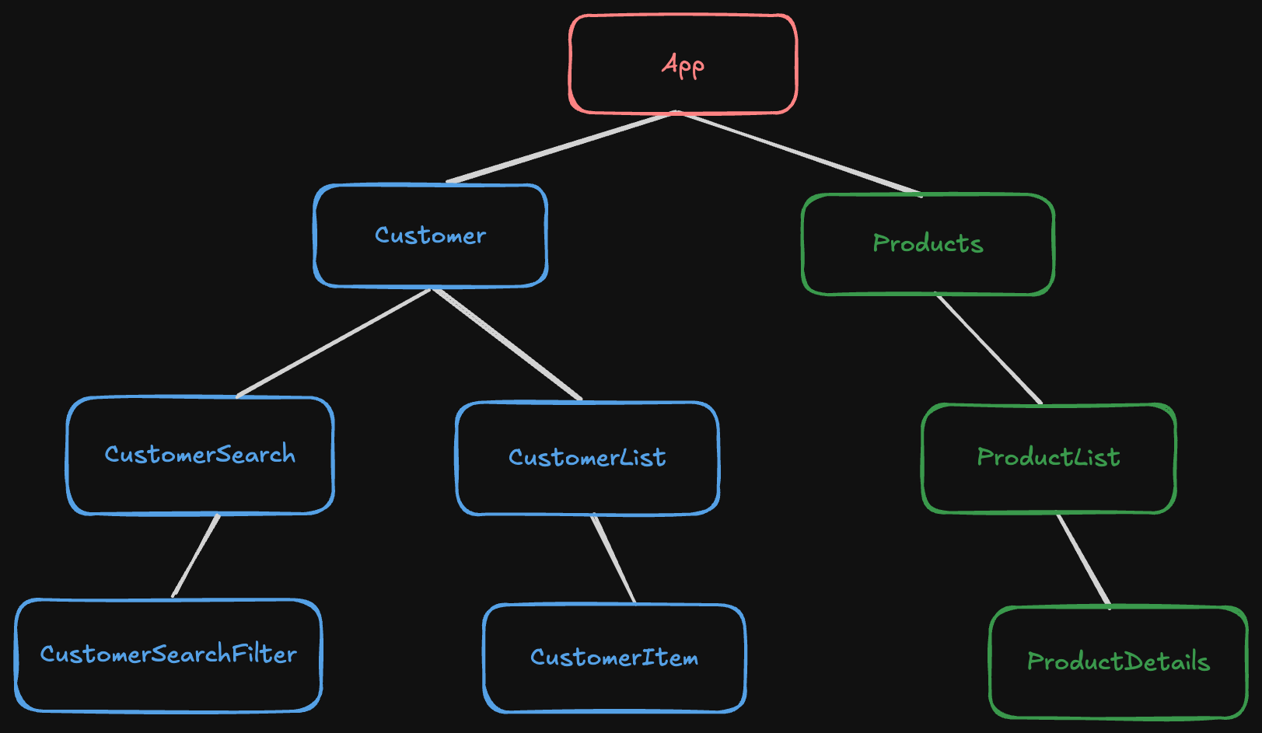

Default
Change Detection

Slide 32
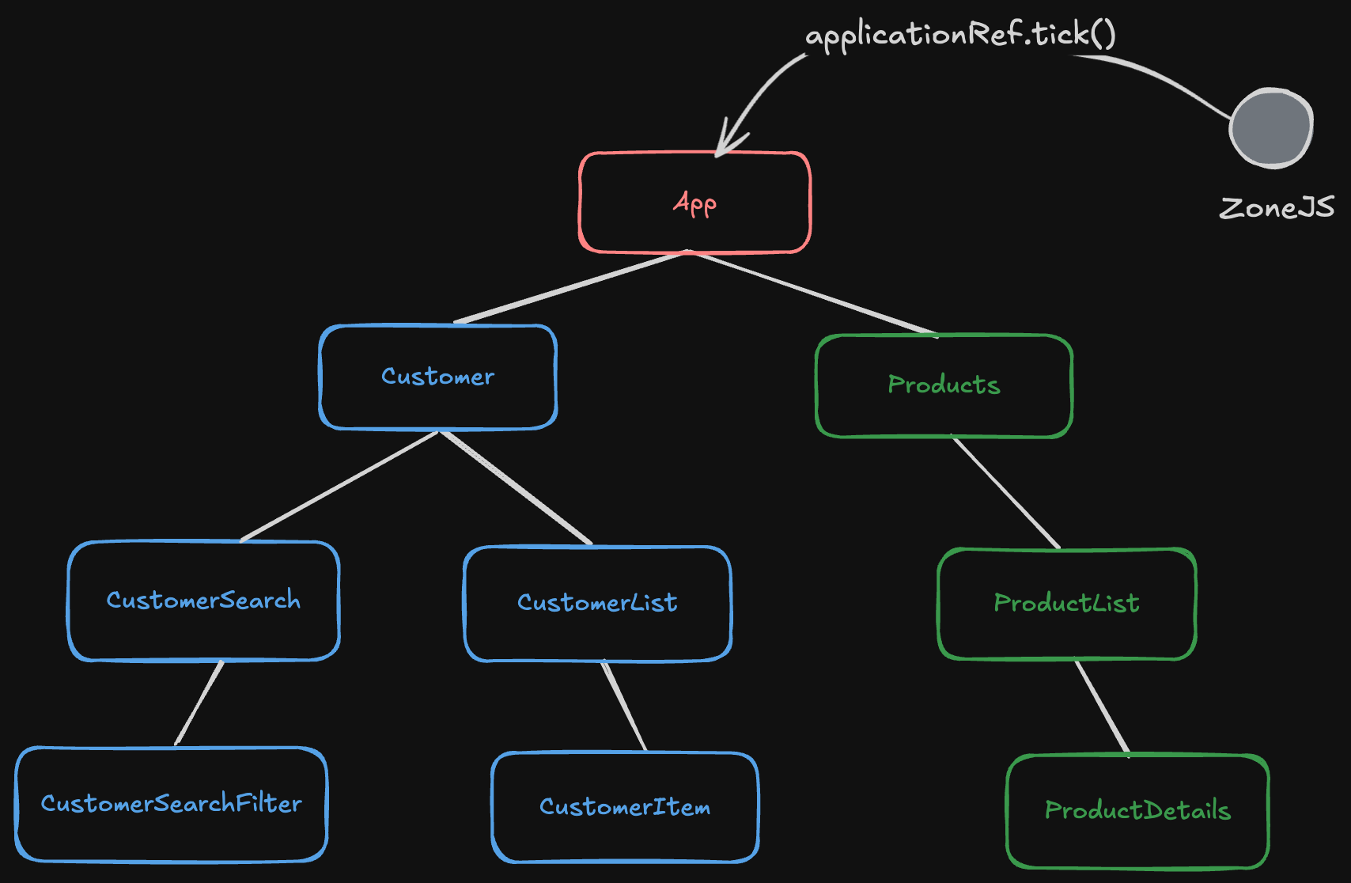
Default
Change Detection

Slide 33
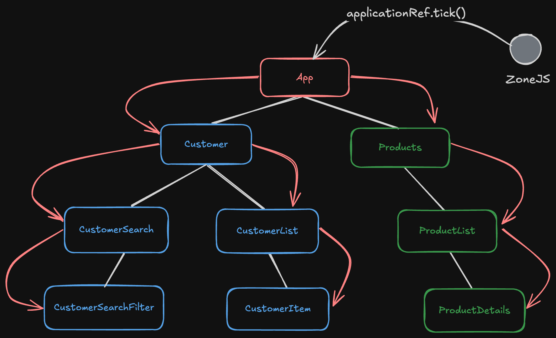
Default
Change Detection

Slide 34
OnPush Change Detection

Slide 35
With OnPush CD runs when
the view is dirty
Reference change on the input
When calling markForCheck() / AsyncPipe()
(Event listener) in template (also calls markForCheck)

Slide 36
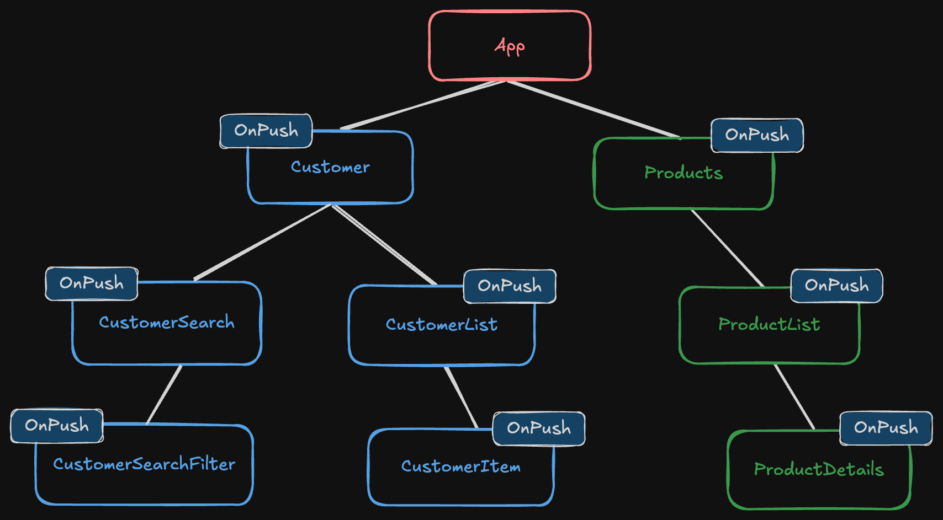
OnPush
Change Detection

Slide 37
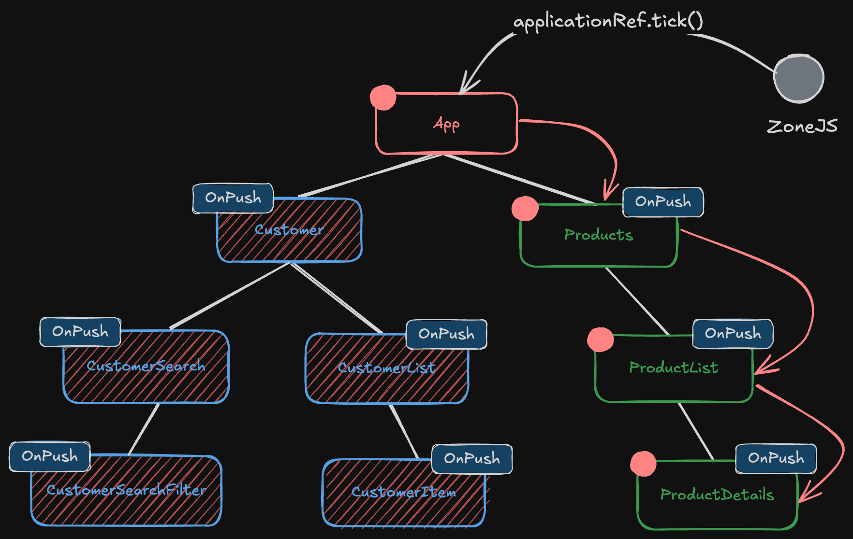
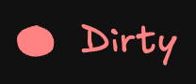
OnPush
Change Detection

Slide 38
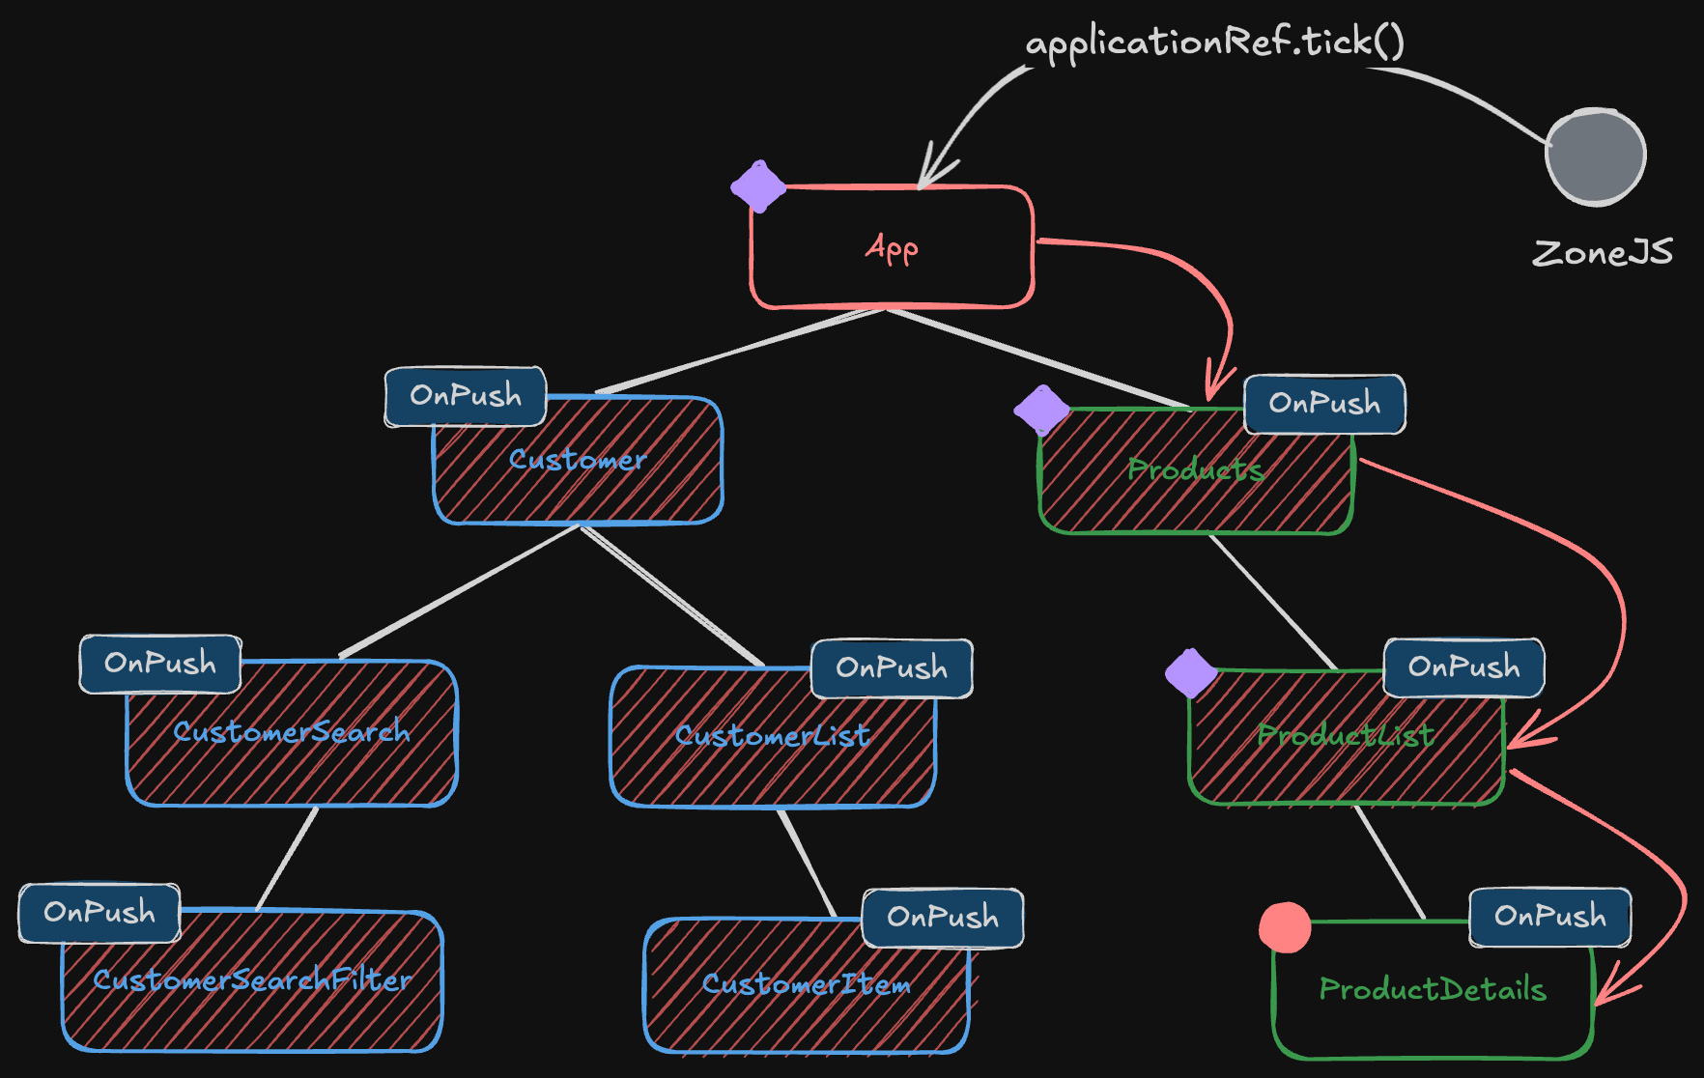

Local
Change Detection

Slide 39
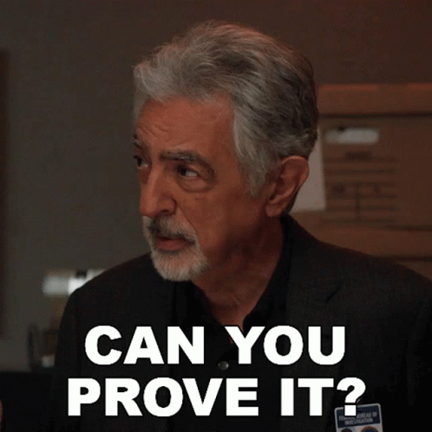
Change Detection
Demo

Slide 40
ZoneJS Downsides
Doesn’t deliver detailed information where a changed happened
Potential for many change detection runs
Initial load cost

Slide 41
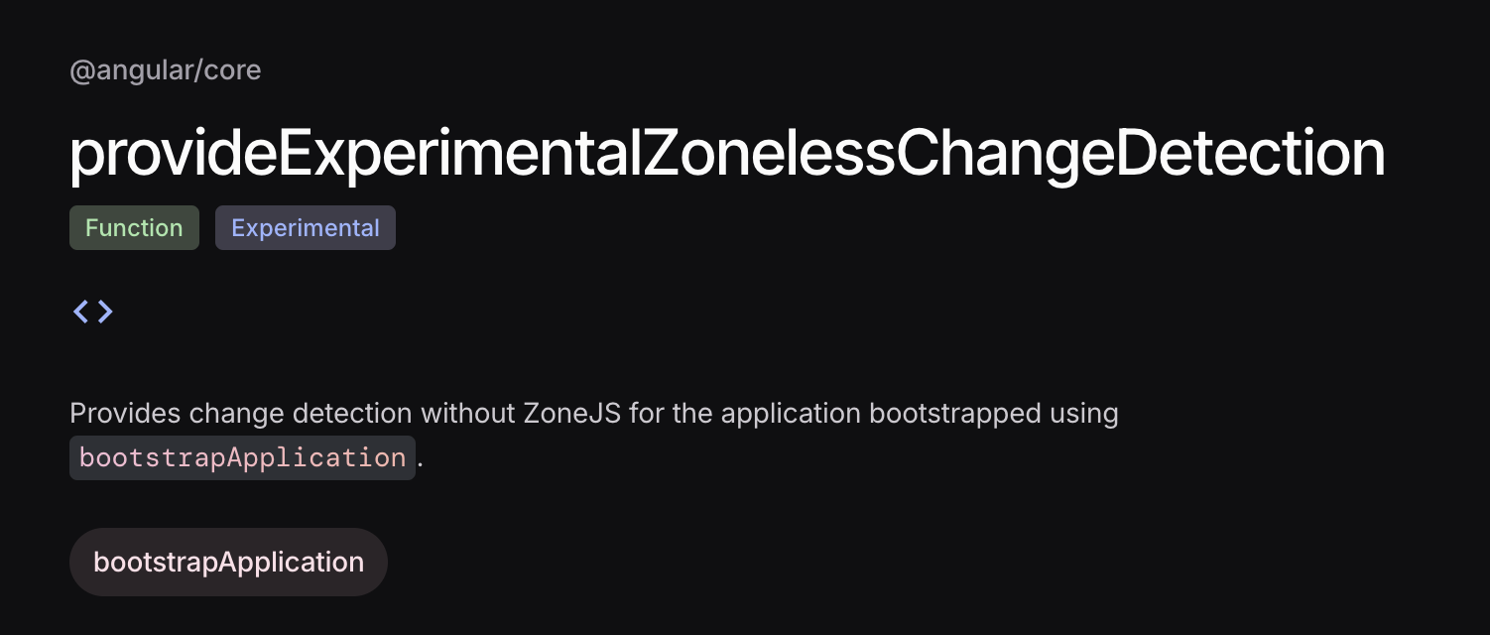
Zoneless

Slide 42
Get ready to go Zoneless
markForCheck (used by async pipe)
Signal changes
Event handlers that mark view dirty
setting inputs on components created dynamically with setInput()

Slide 43

Live Demo

